Slide 1
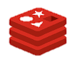
redis
Deborah A., Reema D., Stella L., Yingying P.

Slide 2
Overview
Introduction
Key Concepts
Architecture Overview
Features & Methods
Setup Options
Licensing
Pricing
Cloud-Based Options
Market Metrics
Comparison to Other Databases
Advantages and Disadvantages
Use Cases
Current User
Demo
Source: https://techcrunch.com/2018/05/14/you-can-now-try-smart-compose-in-the-new-gmail/

Slide 3
Question
Is it possible for a database to meet all Cap Theorem requirements: Consistency, Availability, and Partition Tolerance?

Slide 4
Bottom Line Upfront
Whenever data has to be written and retrieved quickly, Redis offers a good alternative to traditional relational databases.
Notes:
However, if you do not require speed and are looking for a database for more complex tasks, you should stick to the traditional solution.
The biggest advantage of Redis is its in-memory key-value data store. It’s extremely fast and flexible and includes built-in data structures (e.g. Lists, Hashes, Sets, Sorted Sets, Bitmaps, Hyperloglog, and Geospatial Indices) that it can perform some data operations more efficiently than relational databases like MySQL.
On the other hand, Redis can complement and extend other databases in your ecosystem very well. So in comparison with MySQL, Redis doesn’t act like a replacement but an accommodation for the drawbacks of the traditional MySQL architecture:
Read/write speeds of traditional databases are not good enough for session stores.
Modifying an existing schema can be complex, which makes it hard to add new features.
Replacing the legacy database is often expensive and risky.
It’s recommended to use Redis as a frontend layer of the database between MySQL and the application like this:
Store application data in MySQL as the system of record.
Store temporary data users engage with as the system of engagement. Most use cases are:
Caching: Caching helps applications retrieve data quickly and limit the load on the database server.
Session Store: Instead of relying on MySQL-like relational databases to persist session data, a single cluster of Redis on decently sized servers with sufficient RAM can manage thousands of sessions.
Real-time Analytics: Gamification through leaderboards, dashboards, polls, messages, counters and other real-time aggregators require constant processing and communication with end-users.
Metering: Redis can also help developers cost-effectively manage the load on legacy servers during peak usage times by rate limiting the number of calls applications make every few seconds.

Slide 5
Introduction
redis
Remote Dictionary Server
Open source NoSQL database management system written in C
No Declarative Query language.Provides proprietary API for building and issuing queries.
Supports several modules including graph modules
It is fast due to its in-memory data persistence
Schemaless structure
Scales vertically and horizontally
Notes:
Redis supports different types of abstract data structures including strings, lists, sets, sorted sets, hashes, bit arrays, streams, hyperloglogs and spatial indexes.

Slide 6
History
2009
Developed by Salvatore Sanfilippo
Built it to improve the scalability by developing a real time web log analyzer
May 2013
Sponsored by Pivotal Software
June 2015
Sponsored by Redis Lab
October 2018
Redis 5.0 was released introducing RediStream
Notes:
Created to improve scalability of his italian startup(real-time web log analyzer)
founder Salvatore Sanfilippo joined Redis labs in 2015

Slide 7
Key Concepts
Claims to be ACID compliant, although it is mostly BASE complaint:
Atomicity: provides transaction related commands including WATCH which ensures operations on the database are indivisible and irreducible
Consistency: Only permitted writes are allowed to be performed through the validation provided by redis
Isolation: Being single-threaded each command or transaction using WATCH,EXEC is thereby isolated
Durability: Can be configured to respond to a client write to confirm that a write operation has been written to disk

Slide 8
Architecture
Built in clustering capabilities
Portions of the database are shared among multiple servers
A server is called a node
Node can be a primary (master) or secondary (slave)
Each node is responsible for only its own set of data
Cluster manager is a independent layer that monitors the overall health of the cluster and the network
Redis runs on Two TCP Ports
Supports both scaling vertically and scaling horizontally
Allows database to be stored not only in RAM but also on Flash memory such as a Solid-State Drive (SSD)
Notes:
Port One Client connection and communication
Port Two Node to node communication.Binary protocol allows nodes to discuss configuration and node availability

Slide 9
Features
Eventually consistent
Ensures durability by using append-only file for every write operation and taking snapshots of the database
Each node of the cluster uses a proxy to provide multi-threaded (asynchronous) communication between client and node
Supports multi-availability zone deployments
Does not support complex aggregates, joins or mapReduce functionalities
Does not have in-built support for SQL queries
Notes:
With AOF and every write ensure that Redis replies to the client after every write operation has been written to disk.

Slide 10
Specific Characteristics
Intelligent caching: used to cache data between an application and a backend store or another relational database
Multi-modal nature : data can be represented for multiple use cases simultaneously
Publisher/Subscriber mechanism : fast moving data generated by thousands and millions of sensors are ingested, analyzed and processed.
RediSearch module : provides features such as scoring,filtering and automatic suggestions based on search(indexes)
Native json handling: JSON-formatted data can be used directly without needing to be transformed
Support for graph modules

Slide 11
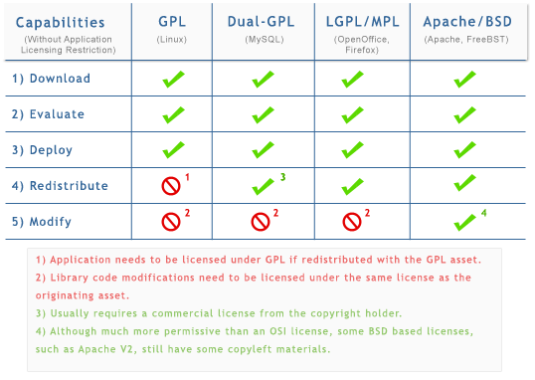
Licensing and Pricing
Open-source software released under a BSD 3-clause license
BSD licenses are a family of permissive free software licenses, imposing minimal restrictions on the use and distribution of covered software.
Source: http://www.bitsandbuzz.com/article/which-open-source-license/
Notes:
Redis is an open-source database. Open source software is made by many people and distributed under a license which grants all the rights to use, study, change, and share the software.
Open Source strategy discussions tend to revolve around licensing. BSD-like licenses allow Redistribution and Modification for software, that’s the major difference between BSD and other licenses.

Slide 12
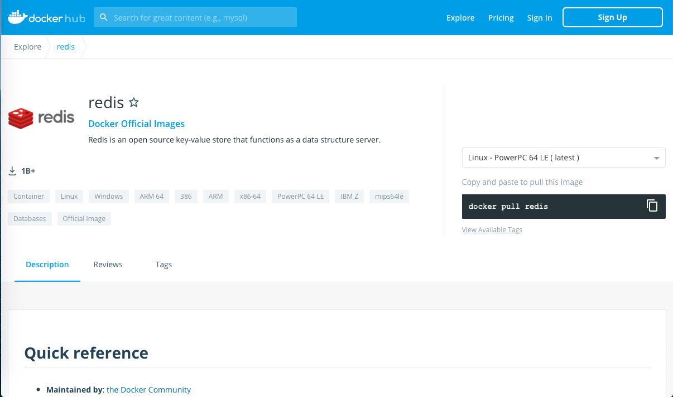
Redis: Docker Containers
Redis is free to download, install and use on local machines. Developers usually implement Redis through Docker containers.
Source: https://hub.docker.com/_/redis
Notes:
Redis is free to download, install and use on local machines. Redis Docker container is an alternative solution to replace legacy Redis Database in proof-of-concept architecture. It’s light-weighted, easy to install, duplicate, launch and stop. Redis Docker is popular and has already been used more than 1 billion times.

Slide 13
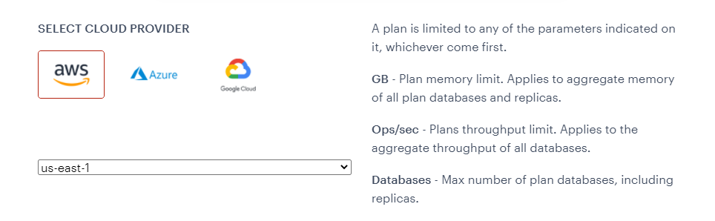
Cloud-based
Redis can be automatically sized, scaled, upgraded, and operated on Microsoft Azure, Google Cloud, or Amazon Web Services
Source: https://redislabs.com/redis-enterprise-software/overview/
Notes:
Redis is supported in all mainstream cloud platforms. Options such as memory limit, throughput limit and number of replicas are usually provided.
In AWS, another in-memory data store called Memcached is also provided. It’s kind of like an upgraded version of redis, with more cost and better performance.

Slide 14
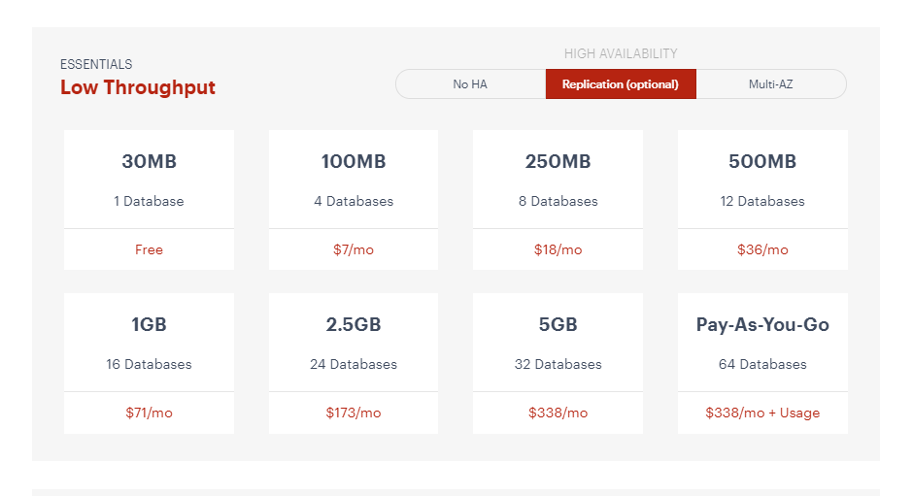
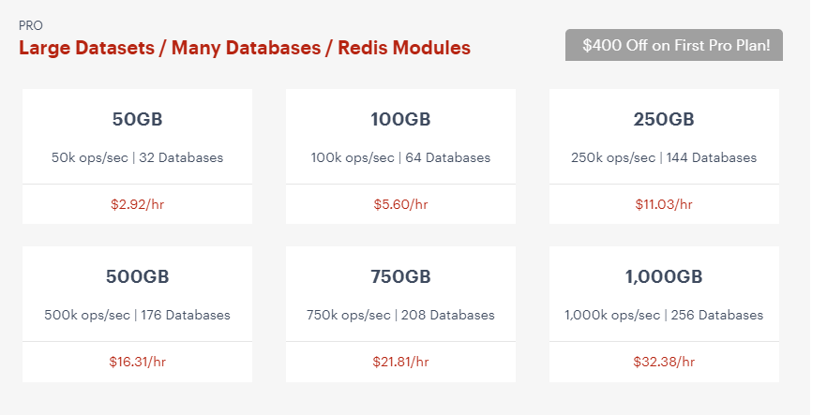
Cloud Pricing
Basic or Professional: Pay as you use
Source: https://redislabs.com/redis-enterprise-software/overview/
Notes:
The Cloud price for redis really depends on the usage, application level, size, availability and scalability. It can even be free to use if it’s only a proof of concept and less than 30Mb. Besides, users can choose pay by month or pay by hour, it’s really flexible and can be optimized based on different use cases.

Slide 15
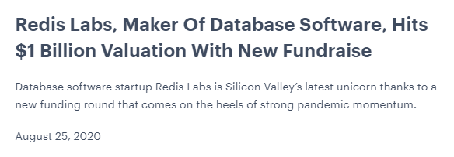
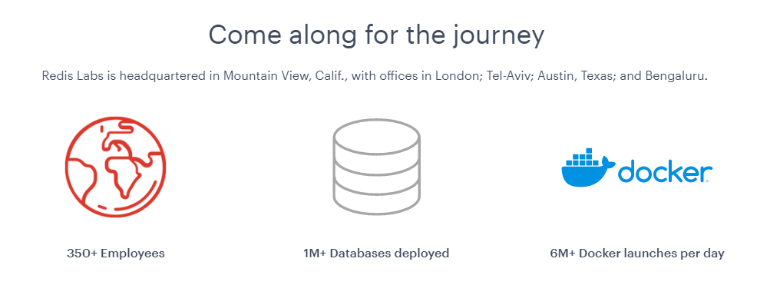
Market Metrics
Source: https://redislabs.com/redis-enterprise-software/overview/
Notes:
Redis is really popular all over the world, over 1 million redis databases have been deployed in the cloud and over 6 million Redis docker containers will be launched every day.
Redis Labs is a private company providing Redis using cloud computing. With the help of Redis’s strong market performance and growth, this company has been growing super fast during recent years.

Slide 16
Comparison
How does Redis compare to other databases?

Slide 17
Capabilities | Redis | MongoDB | Neo4J | MYSQL
Operational Database |  |  |  | ✓
Graph Database | ✓ |  | ✓
Document Database | ✓ | ✓
MapReduce | No | yes | No | No
Shema-full, schema-less. Schema-mix | schema-less | schema-less | schema-free and schema-optional | Shema-full
SQL | No | Read-only SQL queries via the MongoDB Connector for BI | No | Yes
APIs | proprietary protocol | proprietary protocol using JSON | Bolt protocol Cypher query language Java API | ADO.NET JDBC ODBC Proprietary native API
Foreign keys | No | No | No | Yes

Slide 18
Features | Redis | MongoDB | Neo4J | MYSQL
User and Role & Record Security | Simple password-based access control | Access rights for users and roles | Users, roles and permissions. Pluggable authentication with supported standards (LDAP, Active Directory, Kerberos) | Users with fine-grained authorization concept
Consistency concepts | Eventual Consistency Strong eventual consistency with CRDTs | Eventual Consistency Immediate Consistency | Causal and Eventual Consistency configurable in Causal Cluster setup Immediate Consistency in stand-alone mode | Immediate Consistency
ACID Transaction | Optimistic locking, atomic execution of commands blocks and scripts | Multi-document ACID Transactions with snapshot isolation | ACID | ACID
Durability | yes | yes | yes | yes
Sharding | ✓ | ✓ | None | horizontal partitioning, （sharding with MySQL Cluster or MySQL Fabric）

Slide 19
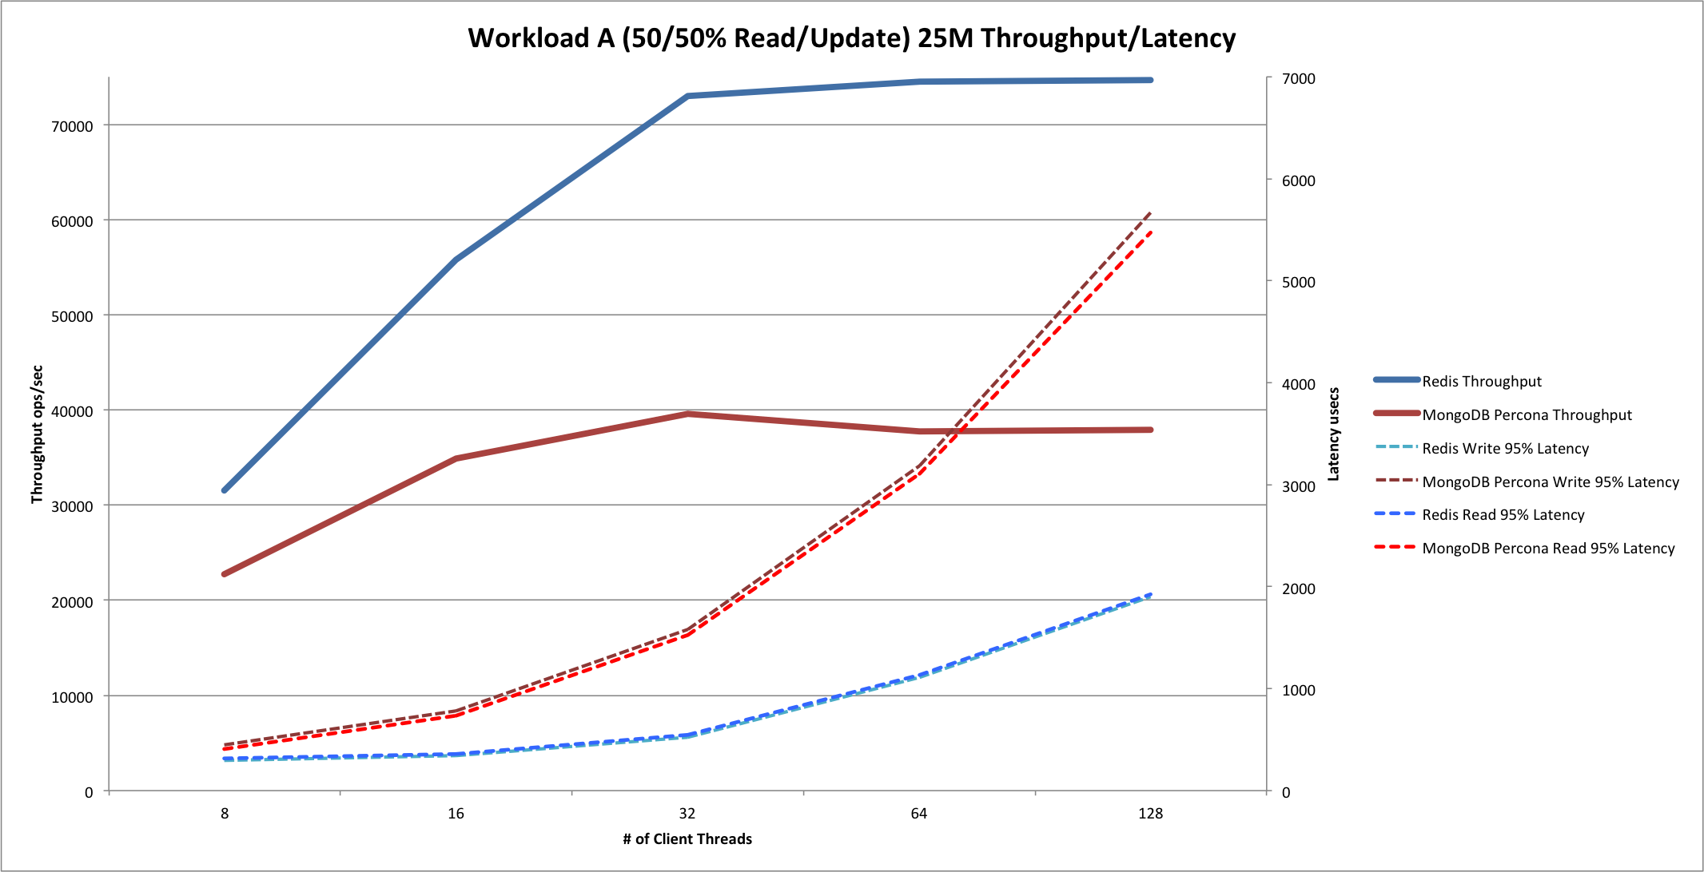
For MongoDB, CPU was saturated by 32 threads onwards. Greater than 300% usage with single-digit idle percentages.
For Redis, CPU utilization never crossed 95%.
For Redis, by 64 threads and above, runs failed often with read-timeout exceptions.

Slide 20
Advantages
Redis is always a good choice if you need simple data to be available quickly. Its standard data backups features allowed an increased read speed: data can be retrieved from different instances. Scaling also works well when using Redis, both horizontally and vertically. If the Redis servers memory is insufficient, the software has built-in virtual memory management. This stores data on the hard drive. Redis itself is written in C, but there are clients for almost every programming language.
Advantages of Redis as a Cache
A well-known caching solution that excels at it.
Redis isn’t a plain cache solution – it has an advanced data structures that provide many powerful ways to save and query data that can’t be achieved with a vanilla key-value cache.
Redis is fairly simple to set up, use and learn.
Redis provides persistence that you can opt to set up, so cache warming in the event of a crash is hassle free.
Notes:
Redis is always a good choice if you need simple data to be available quickly. Due to the fact that it makes standard data backups, the read speed is increased: data can be retrieved from different instances. Scaling also works well when using Redis, both horizontally and vertically. If the Redis server’s memory is insufficient, the software has built-in virtual memory management. This stores data on the hard drive. Redis itself is written in C, but there are clients for almost every programming language.

Slide 21
Disadvantages
If you are working with complex data which requires equally extensive query options, Redis is not the right choice. Generally, data in a key-value store can only be accessed via its keys. In addition, Redis (like other in-memory databases) requires an extremely large amount of memory which can be expensive. You should also expect to provide more memory than the data actually uses.
It doesn’t have inbuilt encryption on the wire.
No role-based account control (RBAC).
There isn’t a seamless, mature clustering solution.
Can be a pain to deploy in large-scale cloud deployments.

Slide 22
Use Cases vs Not Use Cases
Redis will be a better fit for:
Non-structured data
Simple and quick lookups.
Caching layer
Improves performance for scalability issues
Redis will not be a better fit for:
Data will not be frequently queried
Write operation is not much
The amount of data is small
Notes:
When and what type of data to use/not use for this database? Ie is it particularly good for time series analysis or chat rooms etc
The biggest advantage of Redis is its in-memory key-value data store. It’s extremely fast and flexible and includes built-in data structures (e.g. Lists, Hashes, Sets, Sorted Sets, Bitmaps, Hyperloglog, and Geospatial Indices) that it can perform some data operations more efficiently than relational databases like MySQL.
On the other hand, Redis can complement and extend other databases in your ecosystem very well. So in comparison with MySQL, Redis doesn’t act like a replacement but an accommodation for the drawbacks of the traditional MySQL architecture:
Read/write speeds of traditional databases are not good enough for session stores.
Modifying an existing schema can be complex, which makes it hard to add new features.
Replacing the legacy database is often expensive and risky.
It’s recommended to use Redis as a frontend layer of the database between MySQL and the application like this:
Store application data in MySQL as the system of record.
Store temporary data users engage with as the system of engagement. Most use cases are:
Caching: Caching helps applications retrieve data quickly and limit the load on the database server.
Session Store: Instead of relying on MySQL-like relational databases to persist session data, a single cluster of Redis on decently sized servers with sufficient RAM can manage thousands of sessions.
Real-time Analytics: Gamification through leaderboards, dashboards, polls, messages, counters and other real-time aggregators require constant processing and communication with end-users.
Metering: Redis can also help developers cost-effectively manage the load on legacy servers during peak usage times by rate limiting the number of calls applications make every few seconds.

Slide 23
Current Users
Where is redis currently being used?

Slide 24











Key Industries/Customers
Notes:
Entertainment
Technology
Education
Finance
Healthcare

Slide 25

Case Study: HealthStream
HealthStream is dedicated to providing development training to healthcare professionals, such as:
training and learning management
talent management
performance assessment
credentialing
simulation-based training programs

Slide 26
Case Study 1: HealthStream Benefits/Challenges
Challenge: Needs an easy-to-deploy, blazing-fast datastore that could enhance user responsiveness with low operational overhead and high availability
Solution: HealthStream selected Redis Enterprise because it’s demonstrated superb performance, high availability, and operational simplicity, in powering a rollout of new courses.

Slide 27

Case Study 2: Coffee Meets Bagel
Coffee Meets Bagel differentiates itself from other dating apps in that by limiting the number of highly curated matches to its users every day at noon.
Challenge: The platform has attracted 3 million users around the world since its launch in 2012
Company is hoping to expand its international presence and processing upwards of 1TB of data an hour

Slide 28
Case Study 2: Coffee Meets Bagel Benefits
Automated scaling, failover, cluster creation, persistence, and high availability helps Coffee Meets Bagel focus on application innovation
24/7 support, automated operations, significant cost savings on cloud spend, and cloud-agnostic consistency
auto-scaling capabilities have eliminated days of manual effort for scaling during high-traffic times
Non-traditional database structure

Slide 29
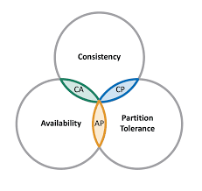
Conclusion
redis is:
A multi-modal database system, with key-value at its core
Performs really well for read operations, scales fast and initial cost of setting up is low
Has no single point of failure as the database is distributed across the cluster

Slide 30
References
“The Best Redis Experience.” Redis Labs, Redis Labs, 19 Aug. 2020, redislabs.com/.
“Redis for Dummies”. John Wiley & Sons Limited Edition 2019
“Wikipedia”. https://en.wikipedia.org/wiki/Redis
https://www.ionos.com/digitalguide/hosting/technical-matters/in-memory-databases/
https://www.ionos.com/digitalguide/online-marketing/web-analytics/dwh-what-is-a-data-warehouse/#c91531

Slide 31
Demo

